Slide 1
SUPERSTORE SALES SQL ANALYSIS
ASHISH POKHRIYAL
MANOJ UCHNEIYA
SNEHA KHANDALE

Slide 2
Contents
Problem Statement
Dashboard
SQL Analysis

Slide 3
Problem Statement
With the constant advancement of technology and innovation, having clear cut databases and possessing departments to breathe life into interpreting them will set you in the top realm of efficiency. Execution is important but we need great inputs to yield even better outputs. There is a necessity to catch up with the growing demand and fierce competition in the market . That is why we need to leverage insights to provide more value to the customer as value is the key to everything.

Slide 4
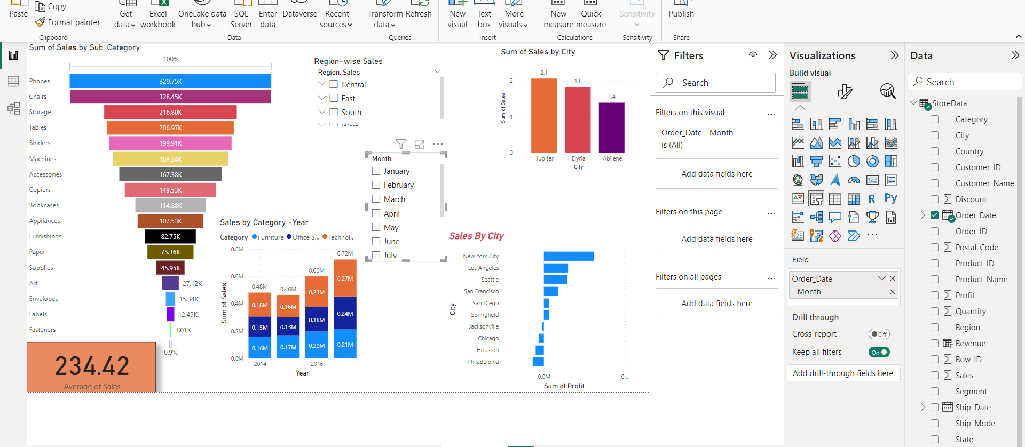
Dash - Board

Slide 5
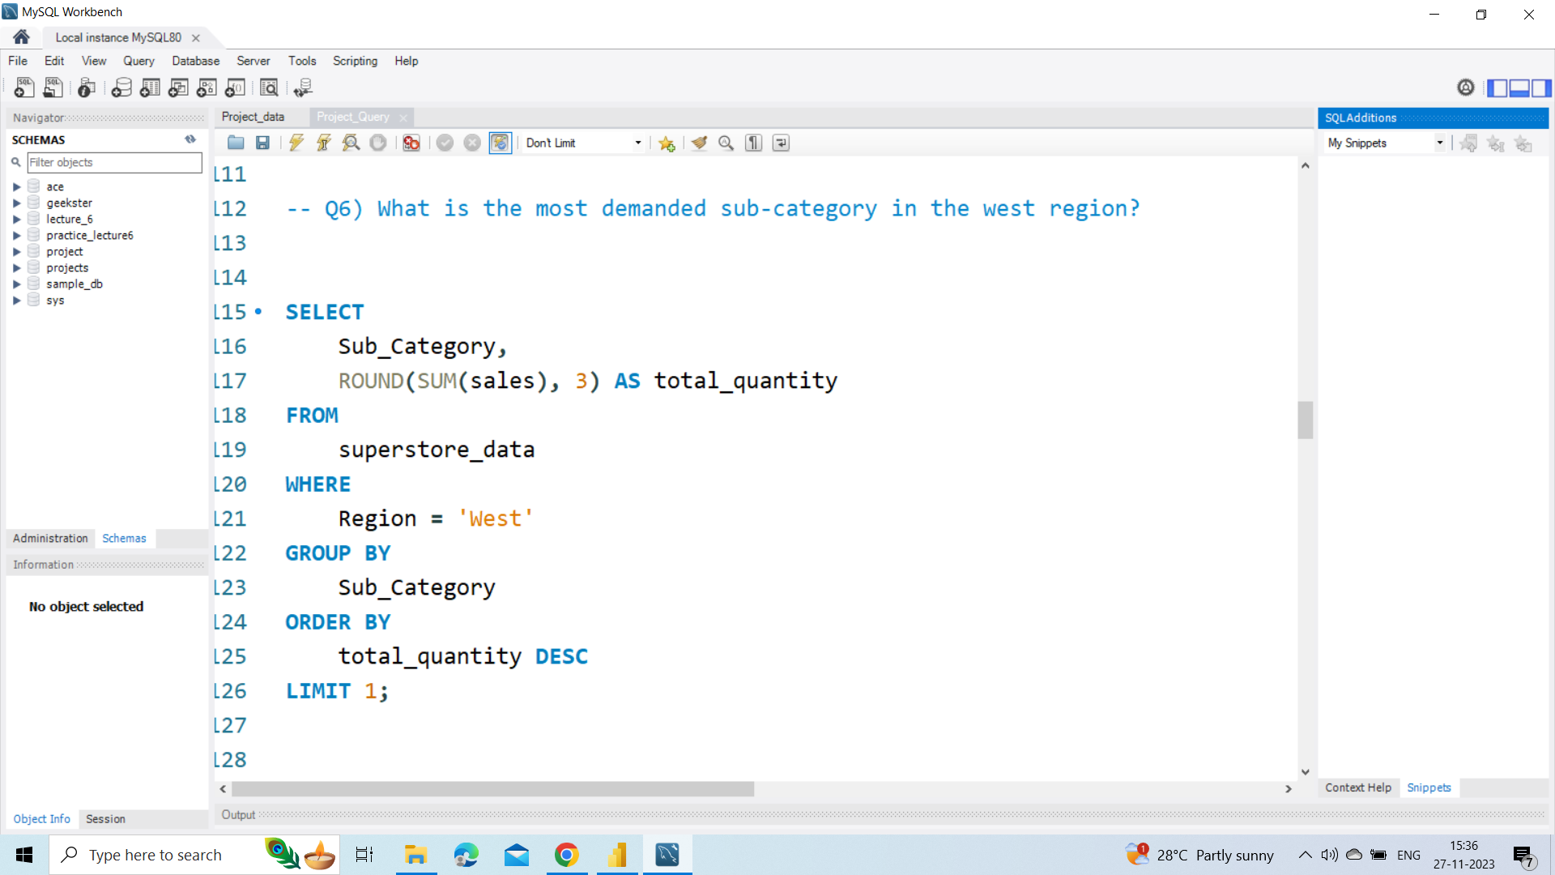

Slide 6
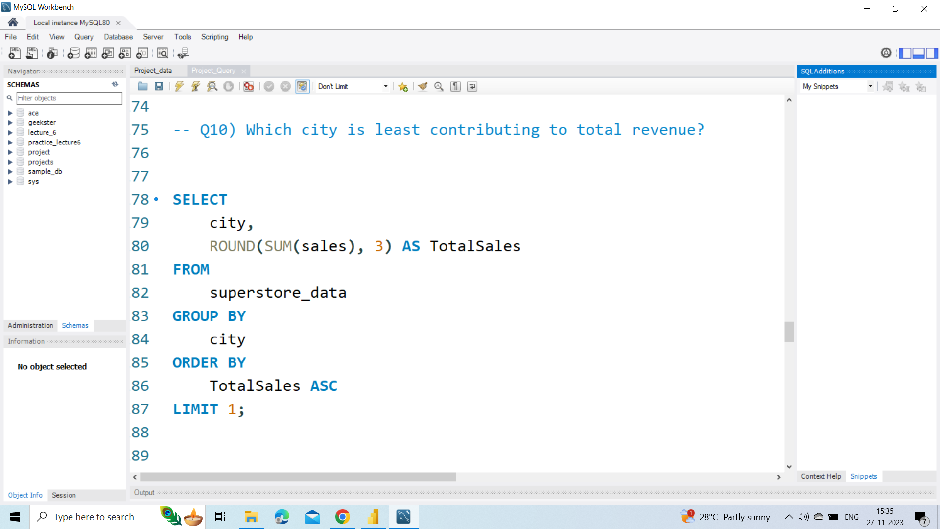

Slide 7
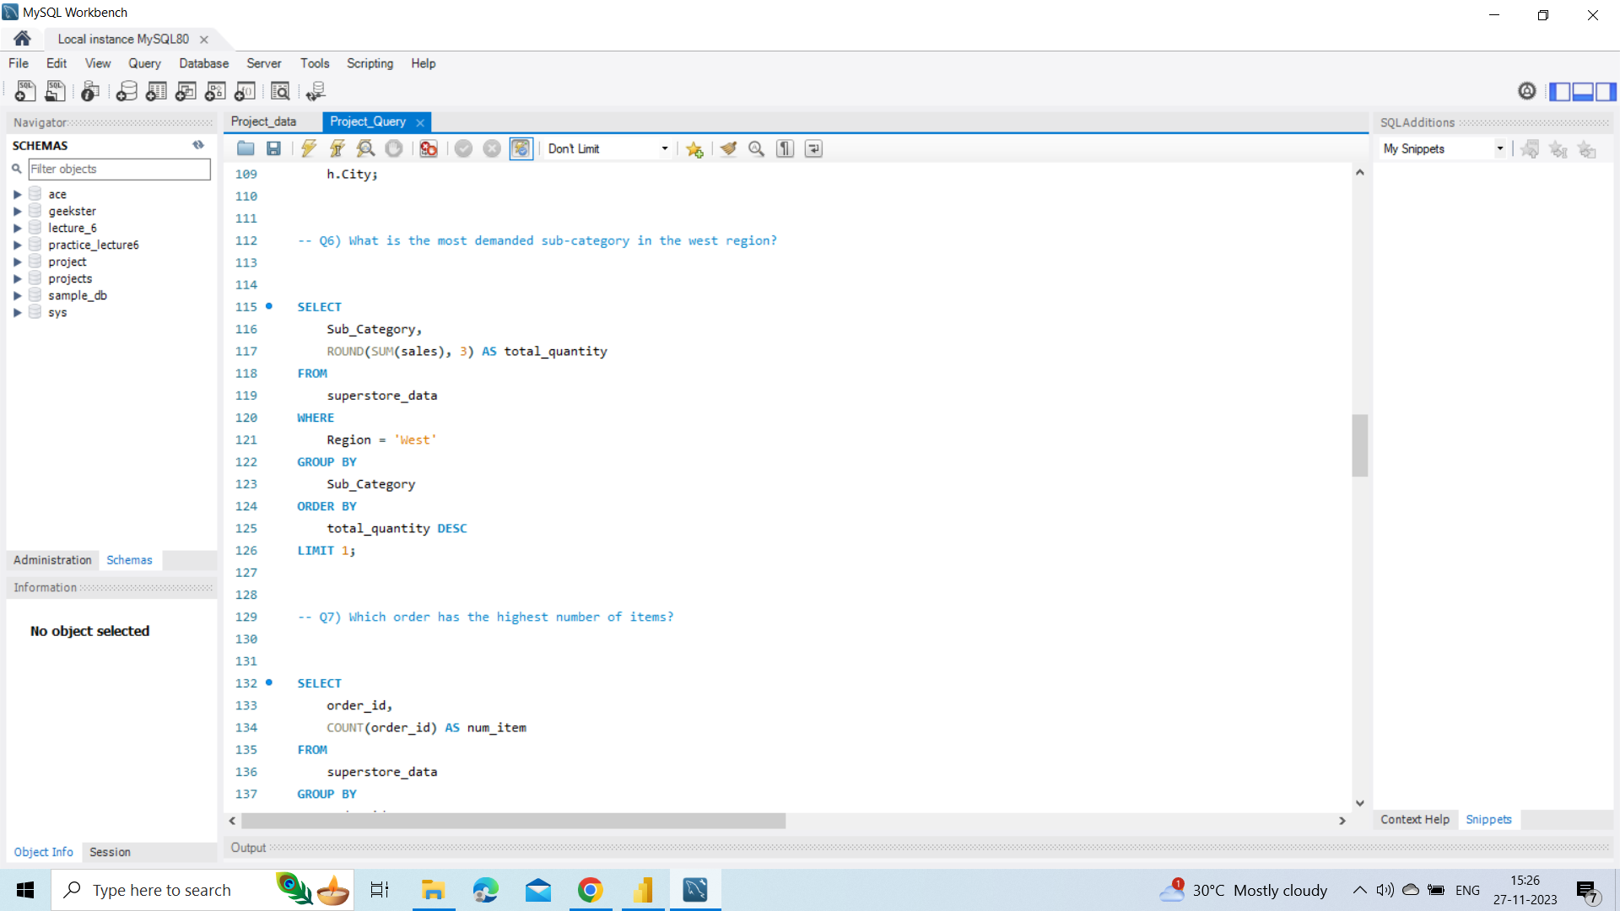

Slide 8
Conclusion:-
It was great working on Superstore sales data based on Region-wise as well with different aspects where I could pull insights using category, Sub-Category, Segments etc. The more profit can be optimized by Category w.r.t to their Month and Year.

Slide 9
Thank You

